Slide 1
Taking R and shiny to production
Gao Maribe, PhD
Data Scientist at dotmodus

Slide 2
From Prototyping to Production
Gao Maribe, PhD
Data Scientist at dotmodus

Slide 3
Building a simple app and deploying it on prem
Gao Maribe, PhD
Data Scientist at dotmodus

Slide 4
Running a really simple shinyapp on a linux machine
Gao Maribe, PhD
Data Scientist at dotmodus

Slide 5
How to take over the world with R
Gao Maribe, PhD
Data Scientist at dotmodus

Slide 6
Demo

Slide 7
Problem statement
Combine two data sets
Attendance data
Student Performance data
Investigate impact using descriptives, t-test, F-test, correlation coefficient.
My Problem:
How will they use this workflow when I no longer work there?

Slide 8
Tools

Slide 9
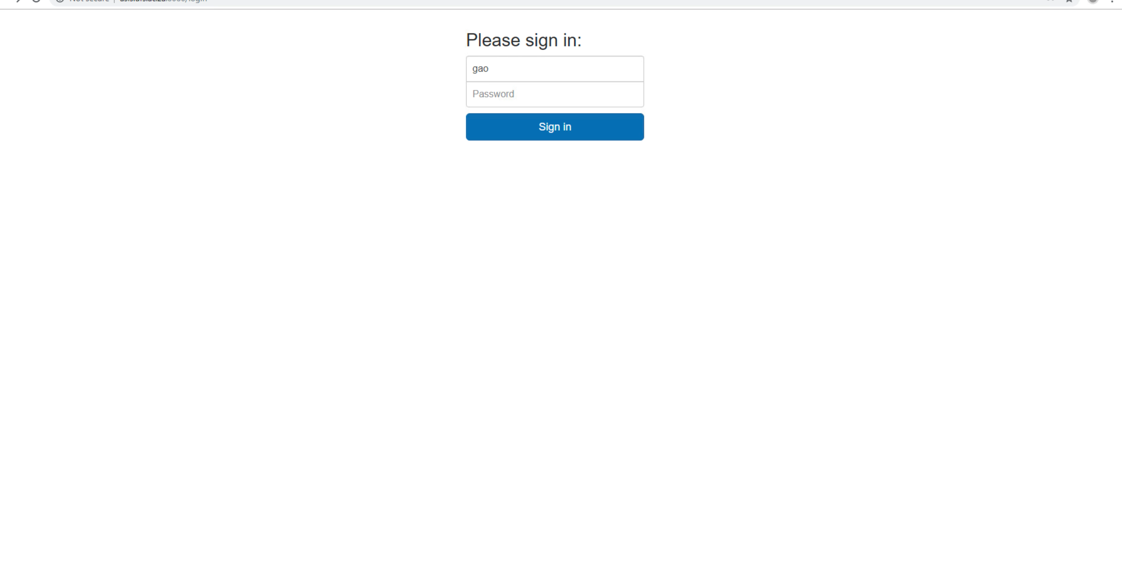


Slide 10
Project structure
Building Shiny application
Testing
Containerizing using docker
Deploy using shinyproxy

Slide 11
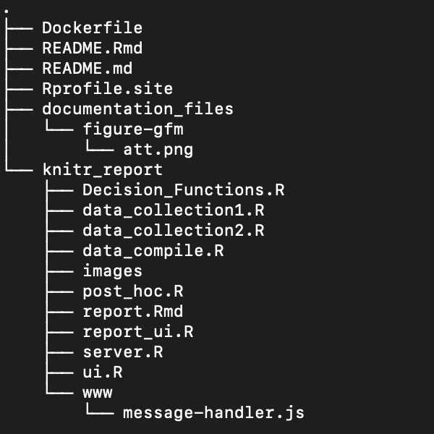

Slide 12
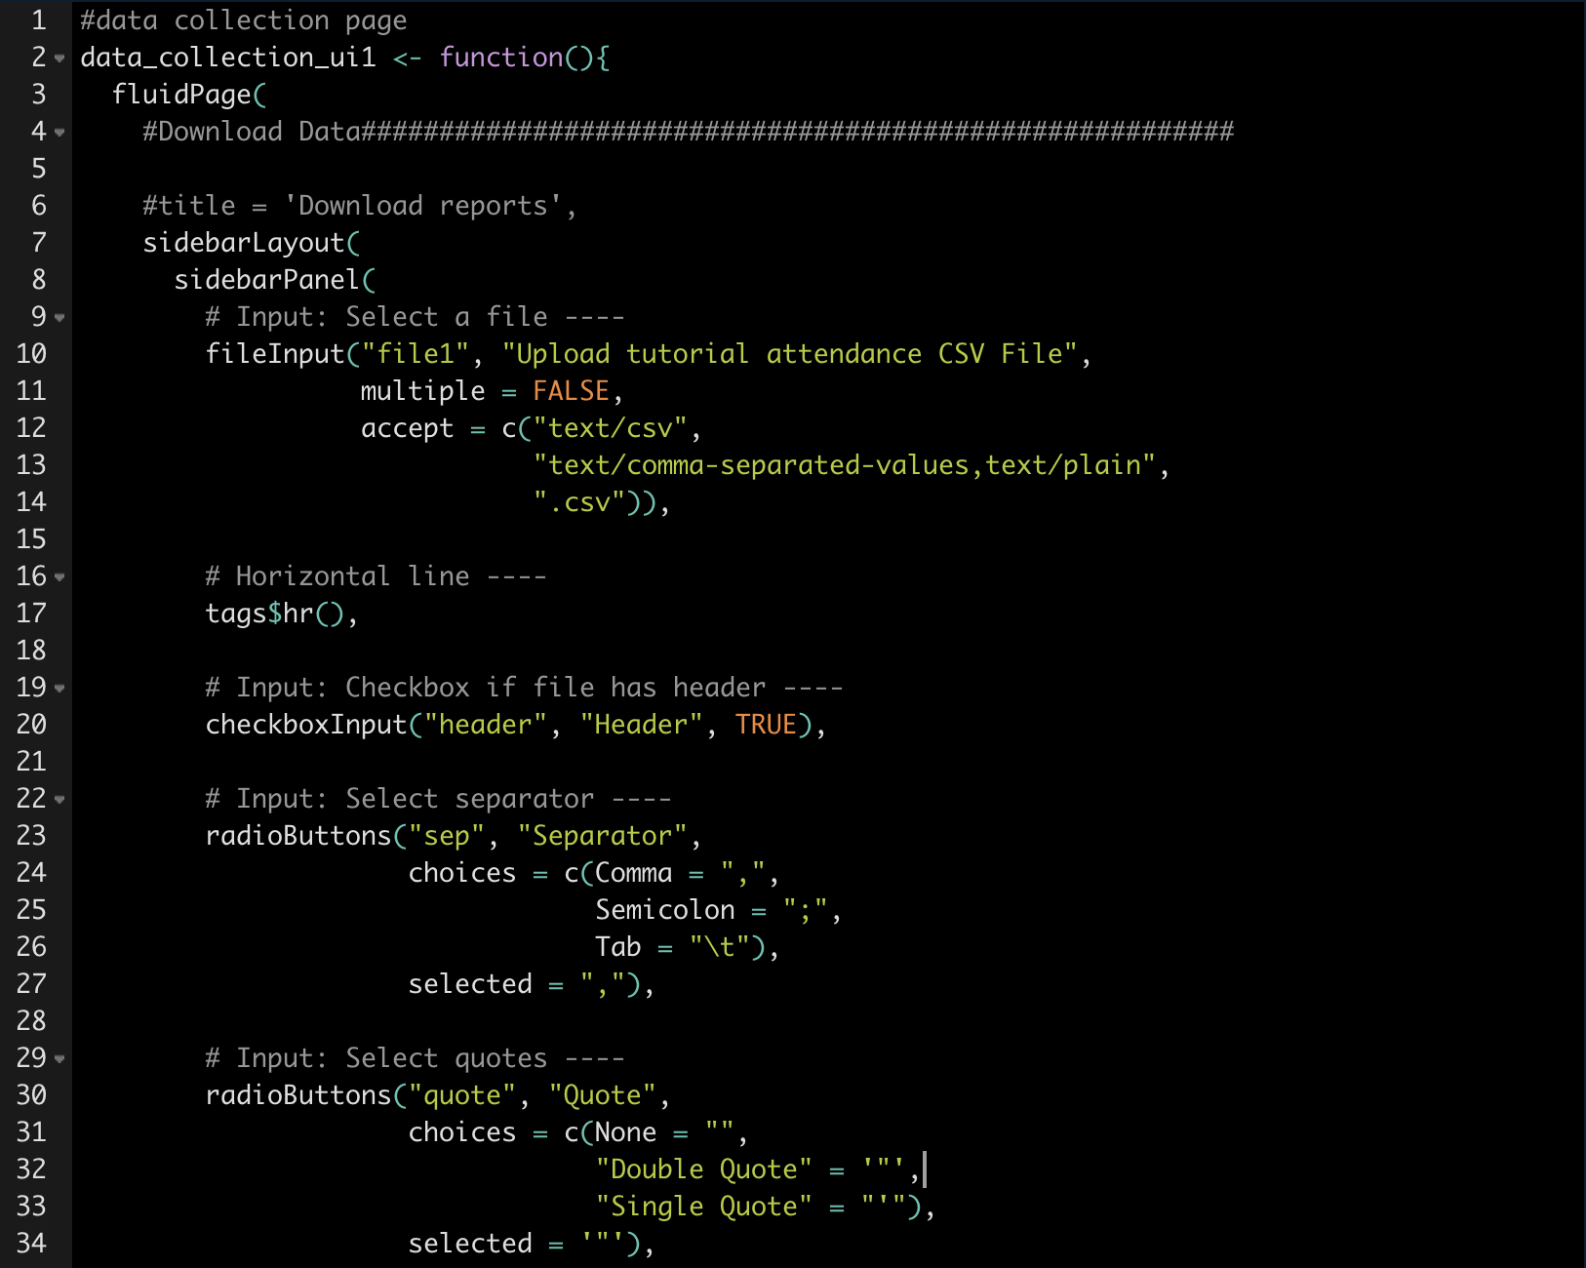

Slide 14
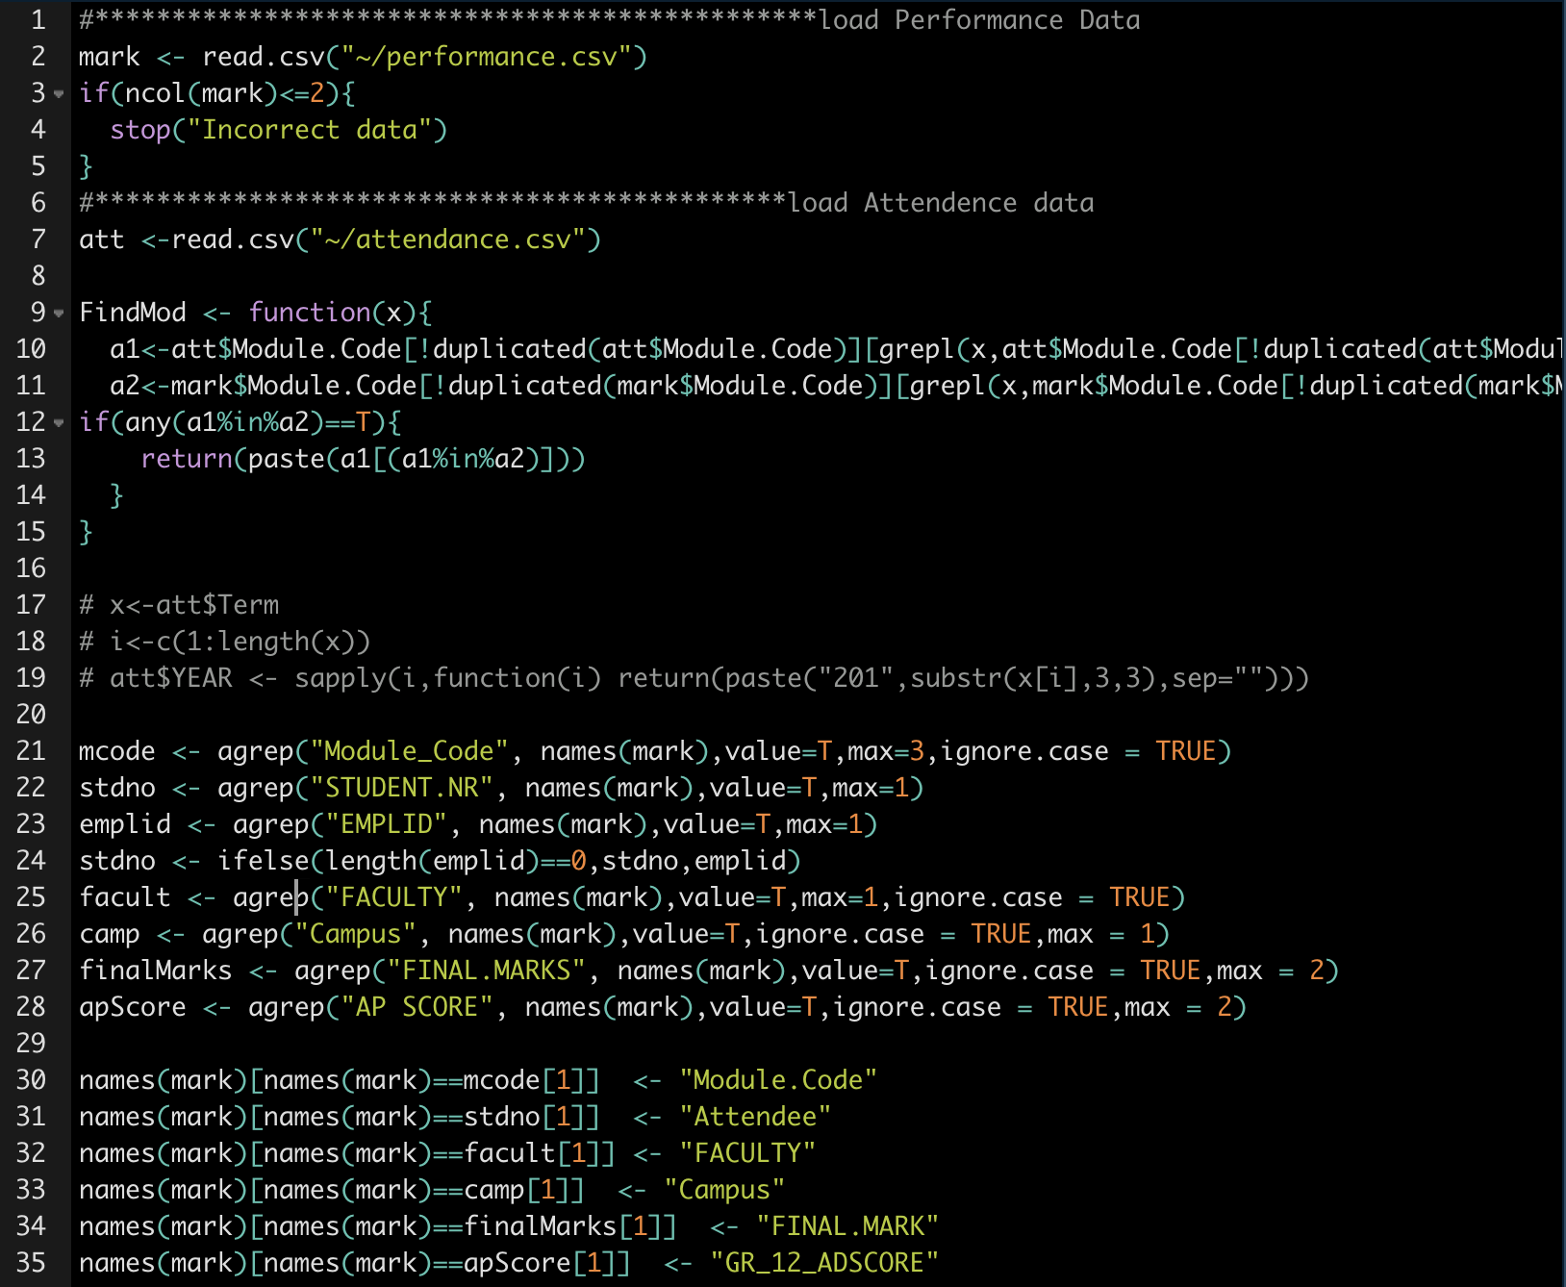

Slide 15
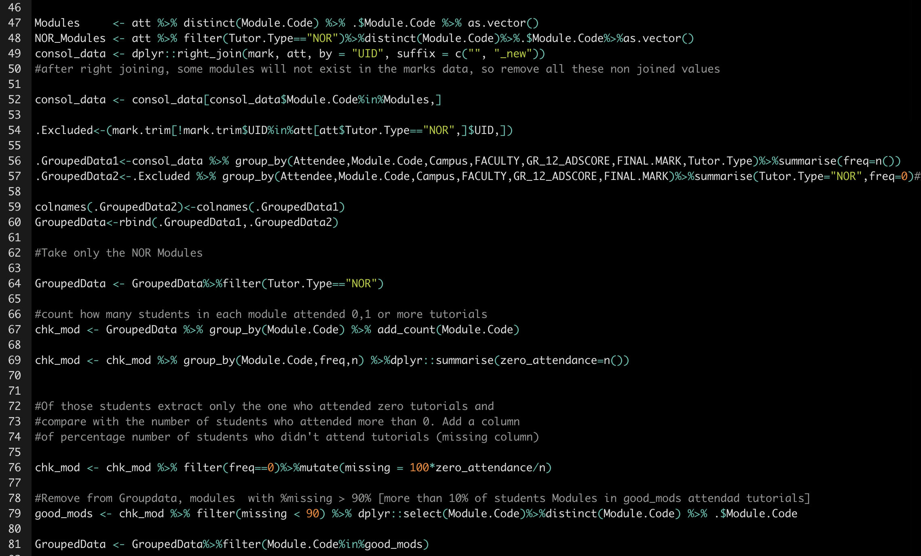

Slide 17
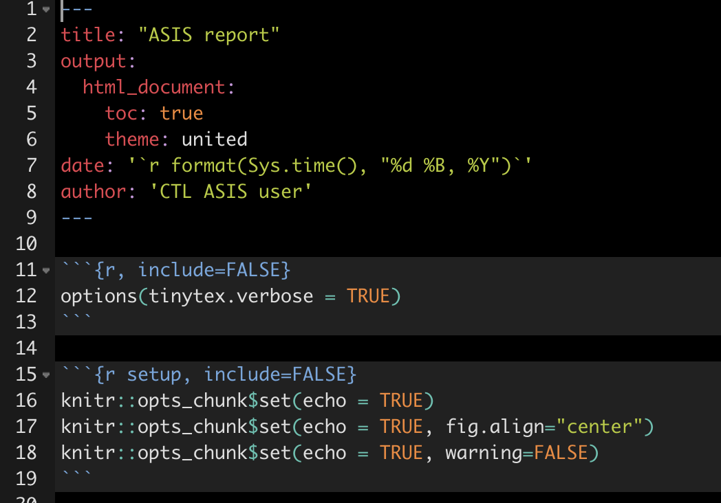
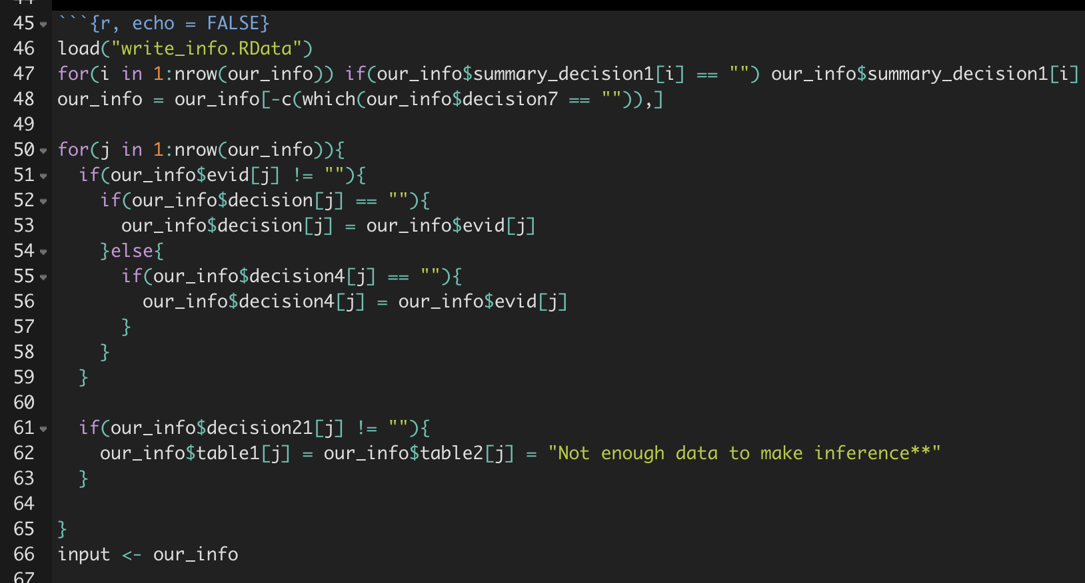
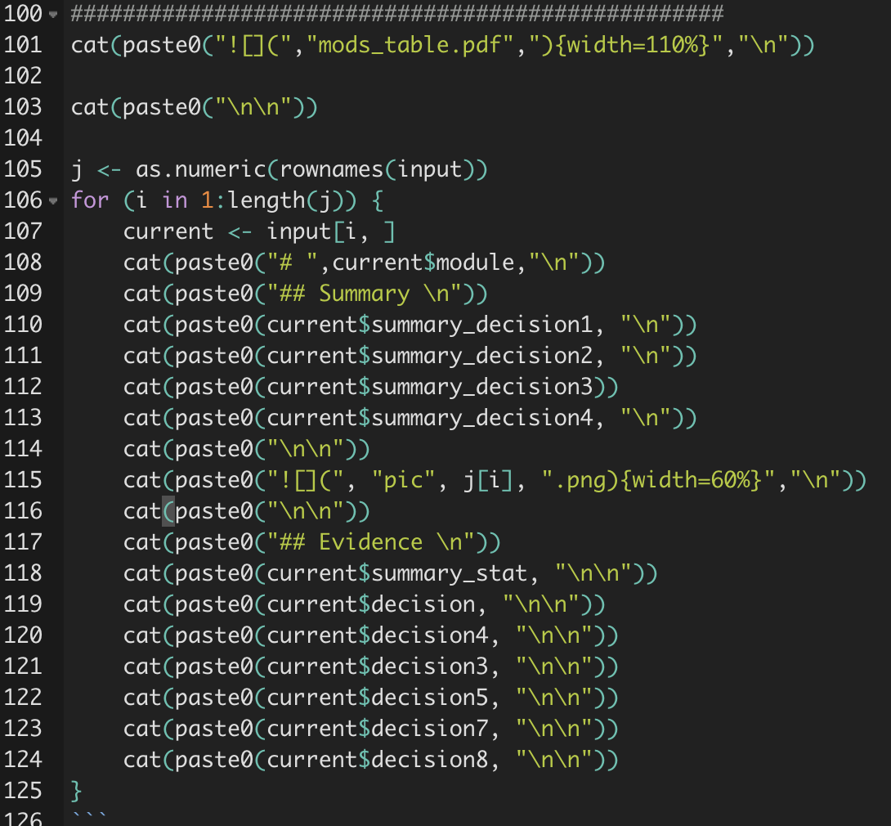

Slide 19

Testing

Slide 20

Containerization

Slide 21
We install Docker CE on our server.
There is a need for some dependencies. It is also better to install the latest version of
Docker CE using Docker servers as a third-party repository.
sudo apt-get install \ apt-transport-https \
ca-certificates \
curl \
gnupg2 \
software-properties-common
curl -fsSL https://download.docker.com/linux/debian/gpg | sudo apt-key add - sudo add-apt-repository \
"deb [arch=amd64] https://download.docker.com/linux/debian \
$(lsb_release -cs) \
stable"
sudo apt-get install docker-ce
Test to see if it works
docker run hello-world

Slide 22
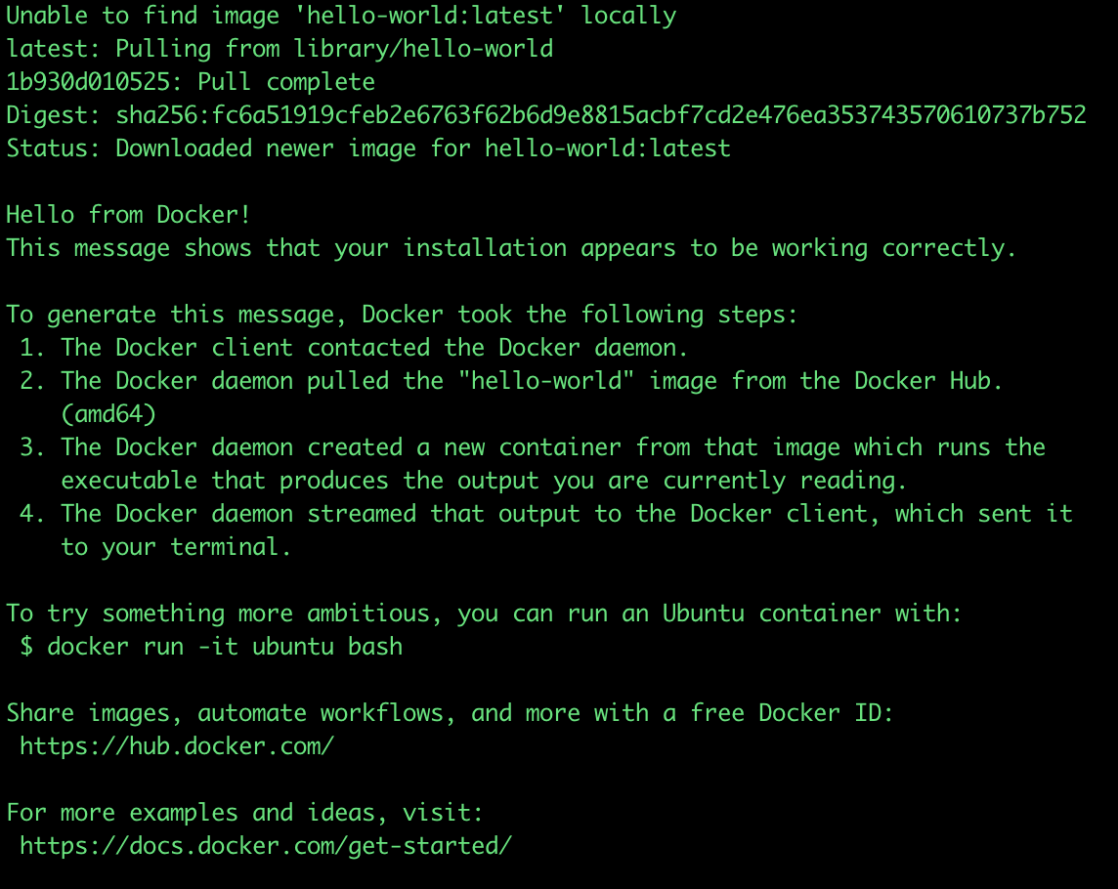

Slide 23



1. To ensure shinyproxy can hook docker instances we Modify the Docker file /lib/systemd/systemd/system/docker.service and restart Docker.
2. Pull our knitr_report project from github and build an image.
git clone https://github.com/atwgao/knitr_report
Navigate to where you placed the Dockerfile and run the following.
sudo docker build -t atwgao/knitr_report .
3. Push image to dockerhub
docker images
docker tag bb38******** atwgao/knitr_report:latest

Slide 24
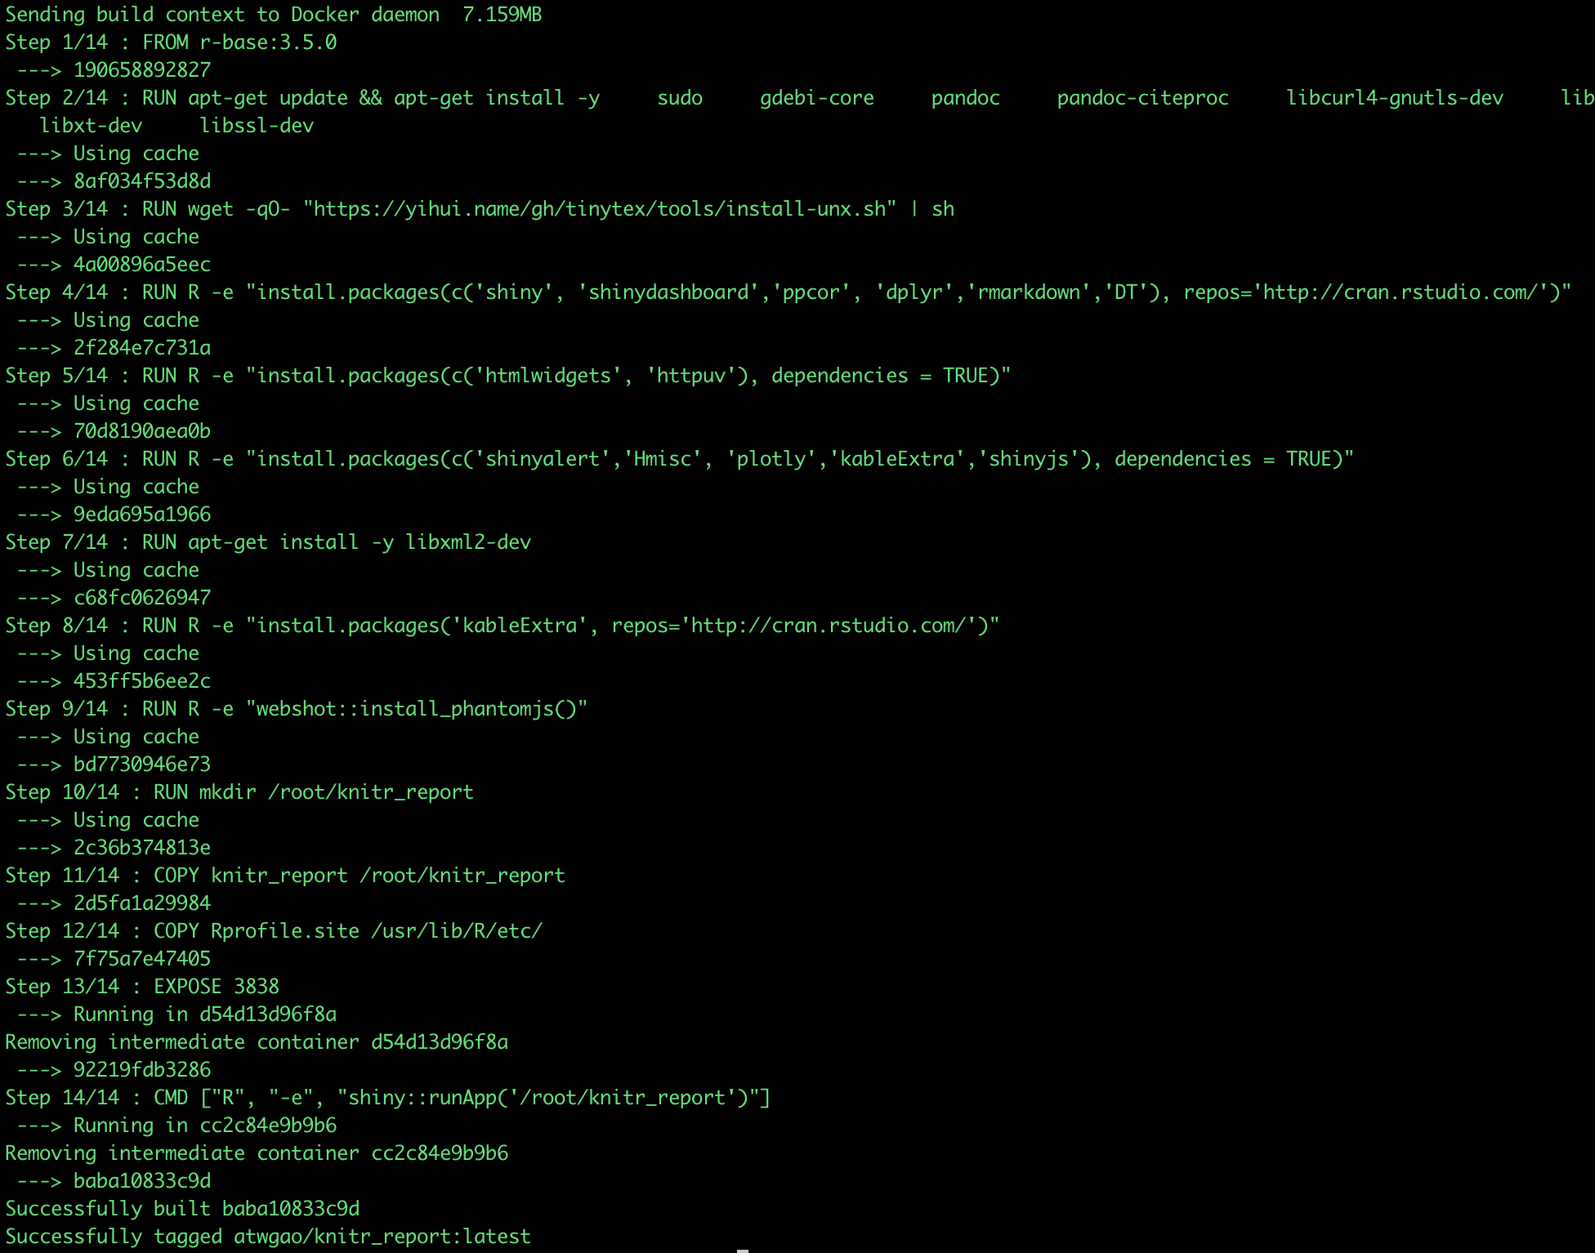

Slide 25

shinyproxy

Slide 26
1. Install Java
Check if it works:
java -version
2. Install shinyproxy which will be used to spin the containers:
wget https://www.shinyproxy.io/download/shinyproxy_2.2.3_amd64.deb
Inside the shinyproxy folder ensure there is a pom.xml file. From that directory. From this directory install shinyproxy (you may need to install maven)
sudo apt install maven
mvn -U clean install
echo "deb http://ppa.launchpad.net/webupd8team/java/ubuntu xenial main" | \ sudo tee /etc/apt/sources.list.d/webupd8team-java.list echo "deb-src http://ppa.launchpad.net/webupd8team/java/ubuntu xenial main" | \ sudo tee -a /etc/apt/sources.list.d/webupd8team-java.list sudo apt-key adv --keyserver hkp://keyserver.ubuntu.com:80 --recv-keys EEA14886 sudo apt-get install oracle-java8-installer

Slide 27
Once shinyproxy is installed you can naviate to the target folder inside the shinyproxy folder and open the application.yml configuration file
proxy:
title: Reporting dashboards
logo-url: https://www.__________________________________
landing-page: /
heartbeat-rate: 10000
heartbeat-timeout: 60000
port: 8080
authentication: simple
admin-groups: tlcs
# Example: 'simple' authentication configuration
users:
- name: gao
password: statement
groups: tlcs
- name: providance
password: password
groups: tlcs
# Example: 'ldap' authentication configuration
ldap:
url: ldap://ldap.forumsys.com:389/dc=example,dc=com
user-dn-pattern: uid={0}
group-search-base:
group-search-filter: (uniqueMember={0})
manager-dn: cn=read-only-admin,dc=example,dc=com
manager-password: password
# Docker configuration
docker:
cert-path: /home/none
url: http://localhost:2375
port-range-start: 20000
specs:
- id: 01_asis
display-name: ASIS
description: This application generates A_STEP impact reports
container-image: atwgao/knitr_report:latest
access-groups: [tlcs]
spring:
servlet:
multipart:
max-file-size: 500MB
max-request-size: 500MB
logging:
file:
shinyproxy.log

Slide 28

Deployment

Slide 29
Navigate to ~/shinyproxy/target and run:
sudo nohup java –jar shinyproxy-2.2.3.jar
For debugging purposes it’s advisable to run without nohup

